Slide 1
In the name of Allah, most gracious and merciful
Object Oriented Concepts &Design with Lab
Lecture – 2
Inheritance

Slide 2
Super Shop:
Find out three real world objects
Mention the two properties and one functionality of the objects

Slide 3



Super Shop
Customer
---------------
ID
Name
accountType
---------------
Buy()
Manager
---------------
ID
Name
salary
---------------
BringProduct()
Employee
---------------
ID
Name
joiningDate
---------------
Cleaning()

Slide 4

Super Shop
Person
---------------
ID
Name
Customer
---------------
accountType
---------------
Buy()
Manager
---------------
salary
---------------
BringProduct()
Employee
---------------
joiningDate
---------------
Cleaning()

Slide 5
What is inheritance
The process of obtaining the data members and methods from one class to another class is known as inheritance

Slide 6
Inheritance
In English:
something that is inherited
inherit : উত্তরাধিকারী হওয়া

Slide 7
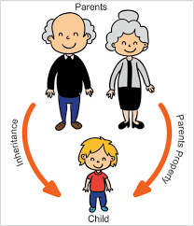

Slide 8
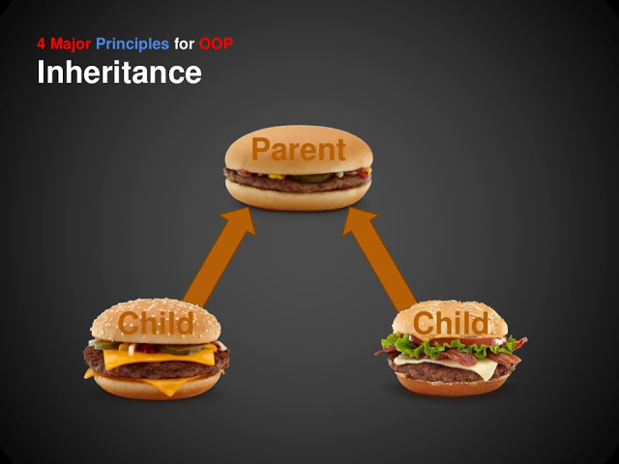

Slide 9
Inheritance: in java
Inheritance in java is a mechanism in which one object acquires all the properties and behaviors of parent object.
The idea behind inheritance in java is that you can create new classes that are built upon existing classes.
When you inherit from an existing class, you can reuse methods and fields of parent class, and you can add new methods and fields also

Slide 10
Use of inheritance
Using inheritance, you can create a general
class that defines common to a set of related items. This class can then be inherited by other classes, each adding those things that are unique to it.

Slide 11
Why do we use inheritance
For code reusability
For class reusability

Slide 12
Inheritance
A class that is inherited is called a super class/ parent class/ base class.
The class that does the inheriting is called a subclass/ child class
A sub class inherits all of the instance variables and methods defined by the superclass and adds its own, unique elements.

Slide 13
class A
{
}
class B :A
{
}
public class Main {
public static void main(String[] args) {
}
}

Slide 14
Inheritance Basics
To inherit a class, you simply incorporate the definition of one class into another by using the extends keyword.
extends keyword indicates that you are making a new class that derives from an existing class

Slide 15
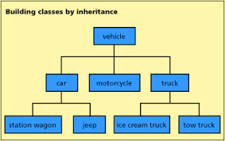

Slide 16
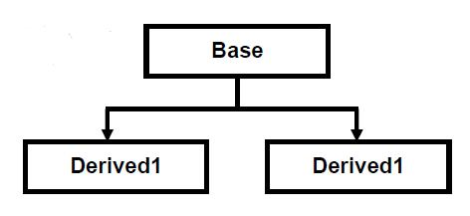
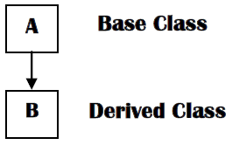
Single inheritance
Example:

Slide 17
using System;
namespace InheritanceApplication
{
class Shape
{
public void setWidth(int w)
{
width = w;
}
public void setHeight(int h)
{
height = h;
}
protected int width;
protected int height;
}
class Rectangle: Shape
{
public int getArea()
{
return (width * height);
}
}
class RectangleTester
{
static void Main(string[] args)
{
Rectangle Rect = new Rectangle();
Rect.setWidth(5);
Rect.setHeight(7);
Console.WriteLine("Total area: {0}", Rect.getArea());
Console.ReadKey();
}
}
}

Slide 18
Member Access and Inheritance
Although a subclass includes all of the members of its superclass, it cannot access those members of the superclass that have been declared as private.
Example:

Slide 19
Inheritance Examples
Car, Cycle
Rice, Soap
Circle
Saving Account, Current Account

Slide 20
Inheritance Implementation: 1
A company named “ABC” which having employees where project manager gets salary 50000.
Show employee’s ID, Name, Designation, Salary and weekly working hour

Slide 21
Inheritance Implementation: 2
A company named “ABC” which having employees where project manager gets salary 50000 and weekly working hour 45 hours, software engineer gets salary 30000 and weekly working hour 42 hours.
Show Each employees ID, Name, Designation, Salary and weekly working hour

Slide 22
Inheritance Implementation: 3
in DIU university there are two persons such as Students and Faculty member, your application will calculate CGPA of students and annual salary of any faculty member.
Display both person’s details.

